Slide 1


Data-Driven Storytelling Presentation:
ACCOUNT PERFORMANCE METRICS
AND
SALES TREND

Slide 2
INTRODUCTION
Problem Statement
J.P. Morgan Chase & Co. is a leading global financial services firm that offers services and operates worldwide.
The company aims to analyze the account performance metrics over the last 5 years (2017-2021) and the factors contributing to its compound annual growth rate (CAGR) in unit sales. This includes identifying opportunities for further improvement.
Business Questions
Examining the total unit sales for each year.
Analyzing the year-over-year growth in sales.
Identifying which account types are surpassing others in terms of unit sales.
Calculating the average 5-year compound annual growth rate (CAGR) based on different account types.
Evaluating the top-performing and bottom-performing accounts.

Slide 3
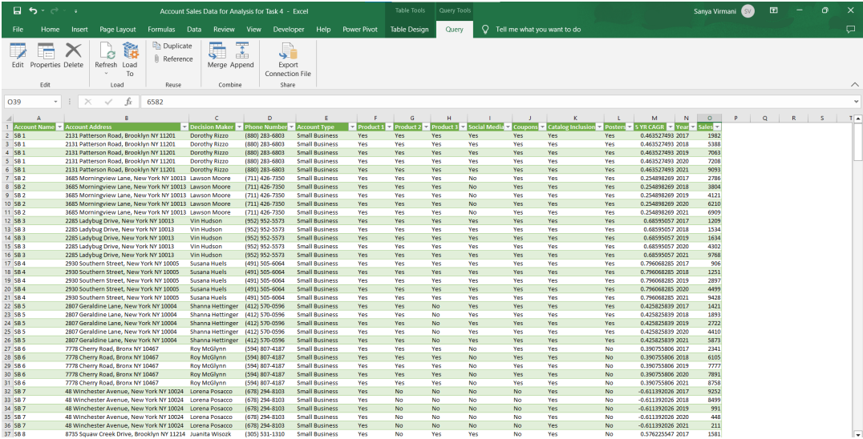
DATA MODELLING
Utilizing Power Query in MS-Excel, transformed the data for improved organization, giving a more structured foundation for necessary analysis.

Slide 4
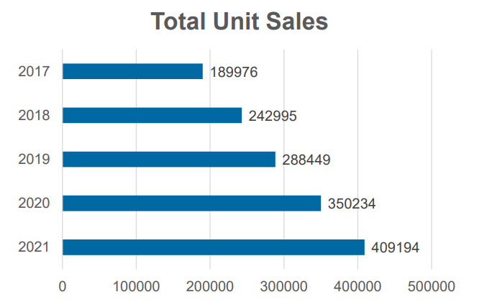
DATA ANALYSIS AND VISUALIZATION
Overall, our unit sales growth has been good, with a 5-year CAGR 0f 21%

Slide 5
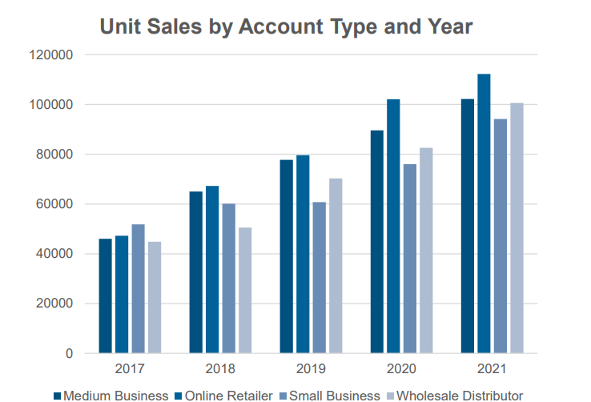
DATA ANALYSIS AND VISUALIZATION
Directing our sales resources and adjusting our sales mix towards online retailer accounts could lead to enhanced sales growth.

Slide 6
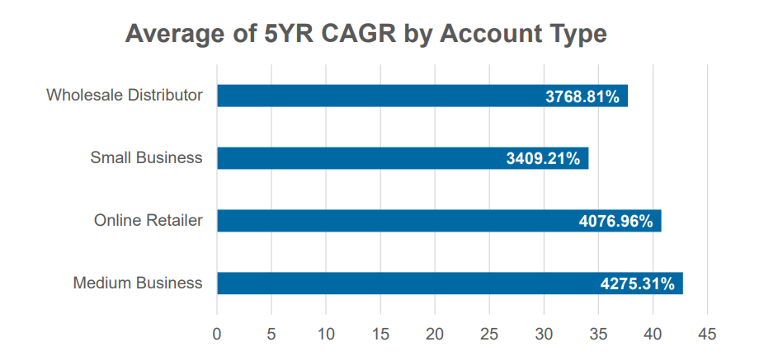
DATA ANALYSIS AND VISUALIZATION
However, Medium Business account type is experiencing higher profitability driven by the average 5-year CAGR.

Slide 7
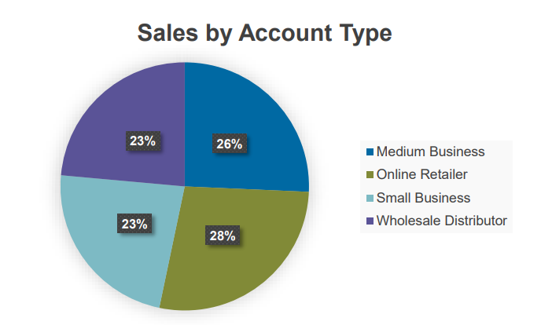
DATA ANALYSIS AND VISUALIZATION
Online Retailer generated the highest sales volume, totaling 408,515 units, which accounts for 28% of the total sales volume.
Medium Business followed closely with a sales volume of 380,568 units, making up 26% of the total sales volume.

Slide 8
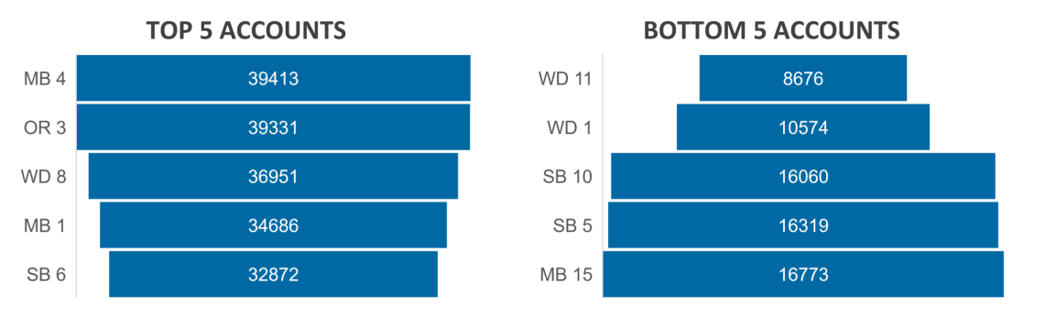
DATA ANALYSIS AND VISUALIZATION
The account name MB4 proved to be the highest-performing account, achieving an impressive sales volume of approximately 39,413 units.
On the other hand, accounts WD11, WD1, and SB10 performed at the lowest level in terms of sales volume. Specifically, WD11 accounted for 8,676 units, WD1 for 10,574 units, and SB10 for 16,060 units, all in terms of sales volume.

Slide 9
SUMMARY
Despite satisfactory overall sales performance, there is ample room for significant improvement.
Discontinuing poorly performing accounts would free up valuable sales and marketing resources.
Notably, the past five years have witnessed the most robust sales growth in the online retailer account category.
By reallocating the resources saved from closing underperforming accounts to online retailer accounts, sales growth could be maximized.
It is advisable to promptly close these underperforming accounts and launch an initiative to identify high-potential online retailer accounts deserving of increased sales and marketing focus.

